Slide 1


Rupin Gore
April 27, 2025
SpaceX Falcon 9 Launch Analysis and Prediction

Slide 2

Outline
Executive Summary
Introduction
Methodology
Results
Conclusion
Appendix

Slide 3
Executive Summary
This project explores historical SpaceX Falcon 9 launches to analyze success factors and build predictive models.
Using data from public APIs and web scraping, we conducted data wrangling, exploratory analysis, and built classification models to predict mission outcomes.
Key outputs include:
Interactive maps
Dashboards
High-accuracy ML models for launch success prediction.

Slide 4
Introduction
Project Background:
- SpaceX is a private aerospace company conducting regular orbital launches.
- Understanding what affects the success of Falcon 9 launches has business and engineering value.
Problem Statement:
- Can we predict the success of a SpaceX launch based on payload, site, orbit, and other features?

Slide 5

Section 1

Slide 6
Methodology
Executive Summary
Data collection methodology:
REST API + Web Scraping
Perform data wrangling
Removing null values and data amputation
Perform exploratory data analysis (EDA) using visualization and SQLite
Perform interactive visual analytics using Folium and Plotly Dash
Perform predictive analysis using classification models
Find best Hyperparameter for SVM, Classification Trees and Logistic Regression

Slide 7
Data Collection
Collected launch data using SpaceX REST API
Supplemented with launch pad proximity data via web scraping
Flowcharts represent API endpoint calls and HTML element parsing

Slide 8
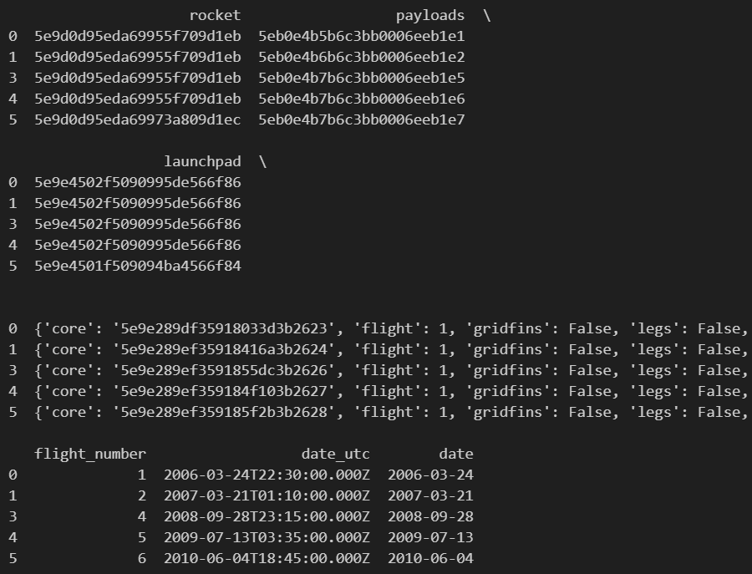
Data Collection – SpaceX API
REST API calls:
https://api.spacexdata.com/v4/rockets/{rocket_id}
https://api.spacexdata.com/v4/launchpads/{launchpad_id}
https://api.spacexdata.com/v4/payloads/{payload_id}
https://api.spacexdata.com/v4/cores/{core['core’]}
GitHub Notebook URL: https://github.com/rupin-gore/Data-Science-Capstone-Project/blob/main/1-data-collection-api.ipynb

Slide 9
Data Collection - Scraping
Scraped Wikipedia for launch pad locations & proximity info
Extracted coordinates and infrastructure features
GitHub Notebook URL: https://github.com/rupin-gore/Data-Science-Capstone-Project/blob/main/2-webscraping.ipynb

Slide 10
Data Wrangling
Removed nulls and duplicates
Merged datasets using pandas
Encoded categorical variables
Created new features (e.g., success label)
GitHub Notebook URL: https://github.com/rupin-gore/Data-Science-Capstone-Project/blob/main/3-spacex-Data%20wrangling.ipynb

Slide 11
EDA with Data Visualization
Visualized distributions and relationships:
Scatter plots: payload vs. success
Bar plots: success rate per orbit
Trend lines over time
GitHub Notebook URL: https://github.com/rupin-gore/Data-Science-Capstone-Project/blob/main/5-eda-dataviz.ipynb

Slide 12
EDA with SQL
SQL Queries performed:
Total launches per site
Average payload mass
Success rate by orbit
GitHub Notebook URL: https://github.com/rupin-gore/Data-Science-Capstone-Project/blob/main/4-eda-sql-sqllite.ipynb

Slide 13
Build an Interactive Map with Folium
Folium Map Highlights:
Markers for all launch sites
Colored circles for success/failure
Proximity to infrastructure (rail, road, coast)
GitHub Notebook URL: https://github.com/rupin-gore/Data-Science-Capstone-Project/blob/main/6-launch-site-location.ipynb

Slide 14
Build a Dashboard with Plotly Dash
Dashboard Features:
Pie chart for success rate per site
Slider for payload mass range
Dynamic scatter plot for outcome vs. payload
GitHub Notebook URL: https://github.com/rupin-gore/Data-Science-Capstone-Project/blob/main/6-launch-site-location.ipynb

Slide 15
Predictive Analysis (Classification)
Classification Models Used:
Logistic Regression
Support Vector Machine
Random Forest
Model Development Steps:
Feature selection
Train-test split
Hyperparameter tuning
GitHub Notebook URL: https://github.com/rupin-gore/Data-Science-Capstone-Project/blob/main/7-Machine-Learning-Prediction.ipynb

Slide 16
Results
Exploratory data analysis results
Interactive analytics demo in screenshots
Predictive analysis results

Slide 17

Section 2

Slide 18
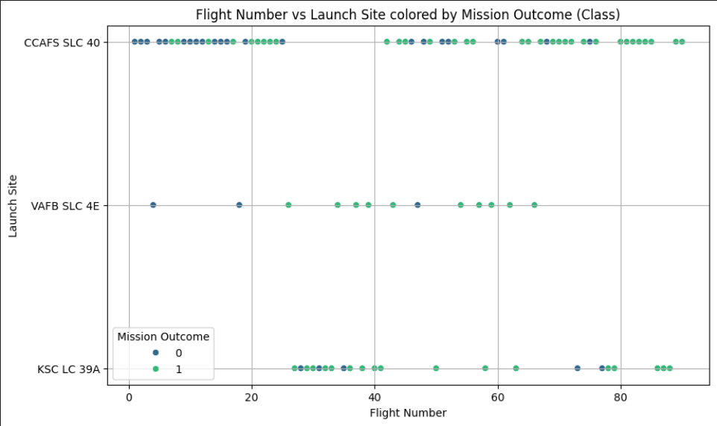
Flight Number vs. Launch Site

Slide 19
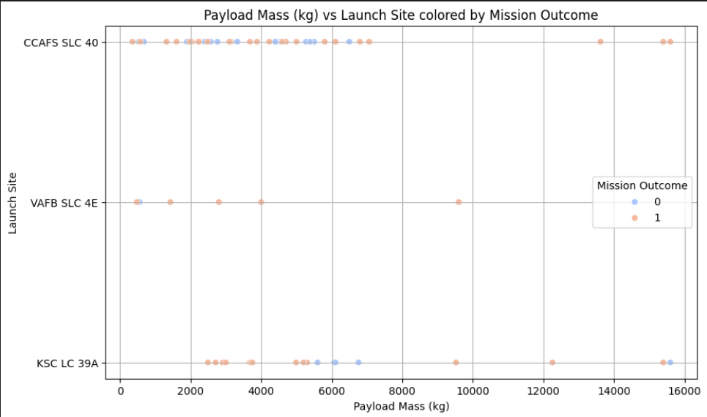
Payload vs. Launch Site

Slide 20
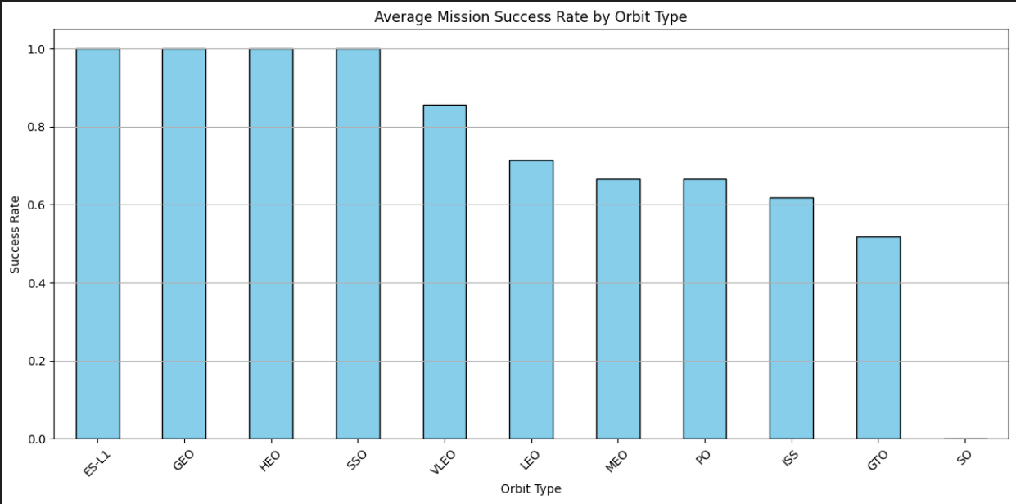
Success Rate vs. Orbit Type

Slide 21
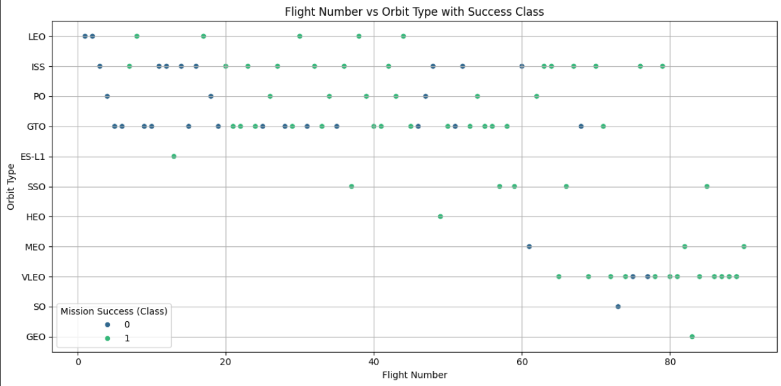
Flight Number vs. Orbit Type

Slide 22
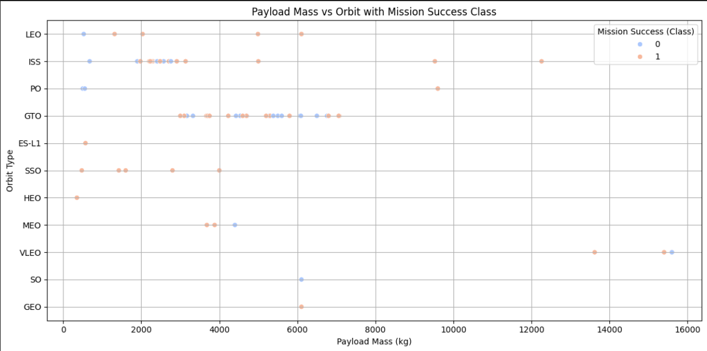
Payload vs. Orbit Type

Slide 23
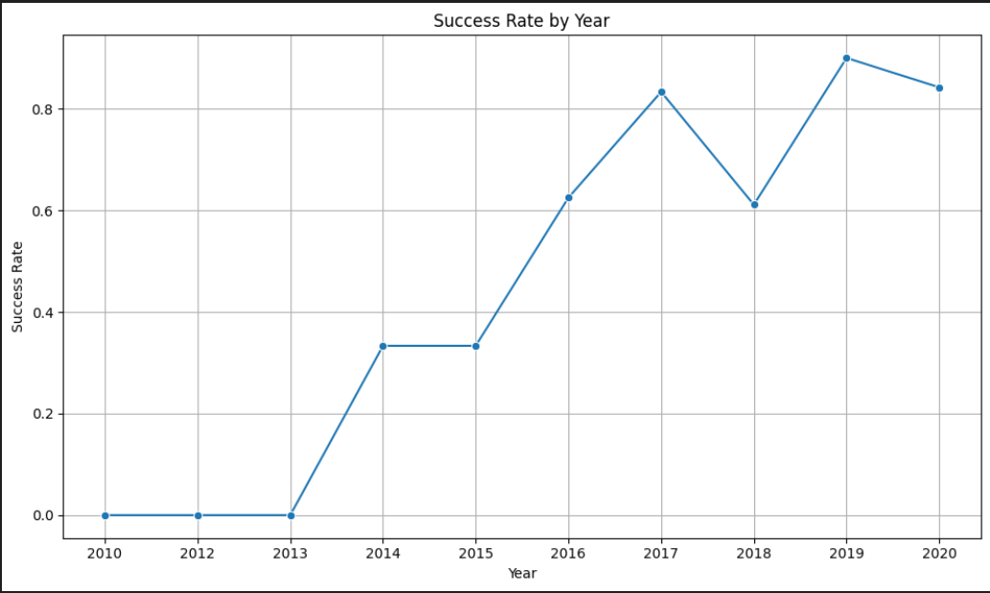
Launch Success Yearly Trend

Slide 24
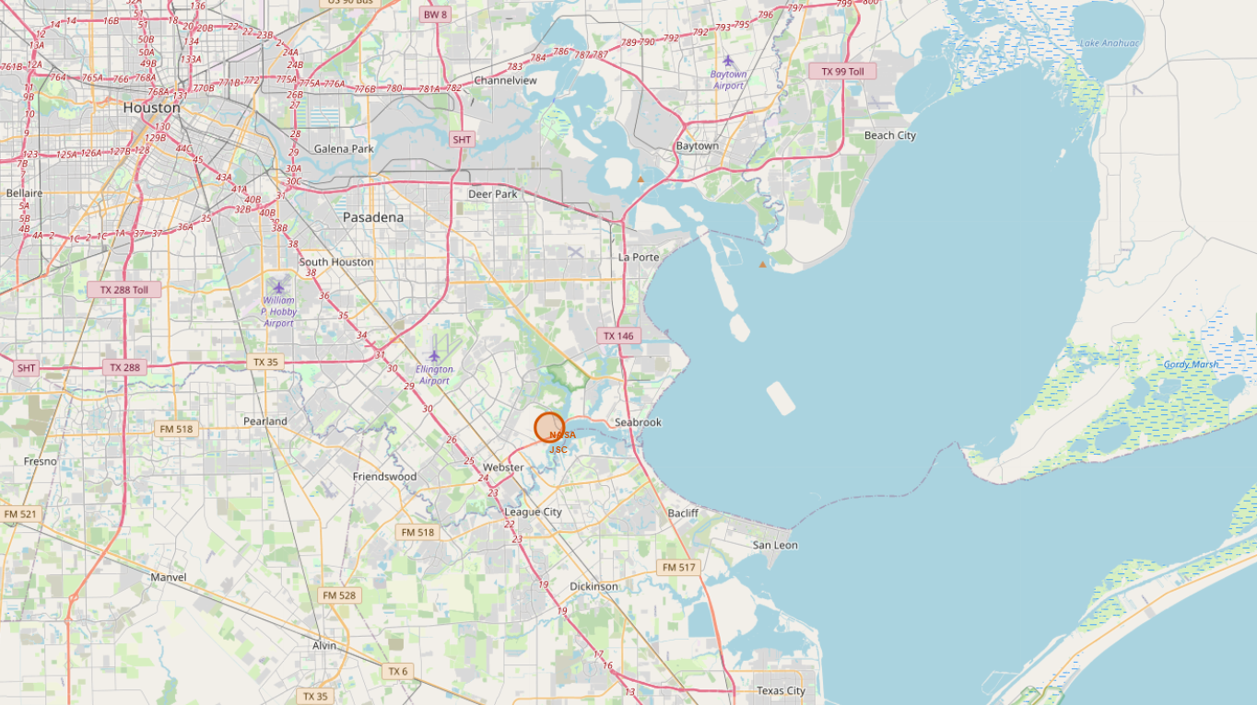
All Launch Site Names

Slide 25
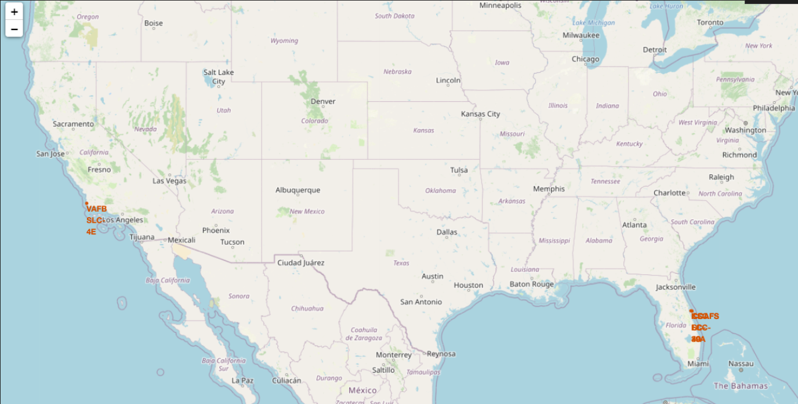
Launch Site Names Begin with 'CCA'

Slide 26
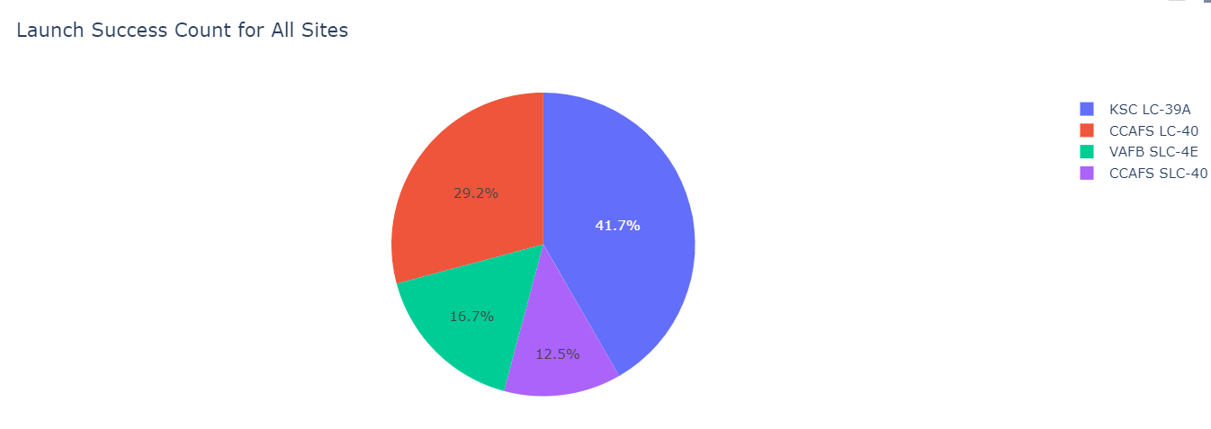
Total Payload Mass

Slide 27

Section 3

Slide 28
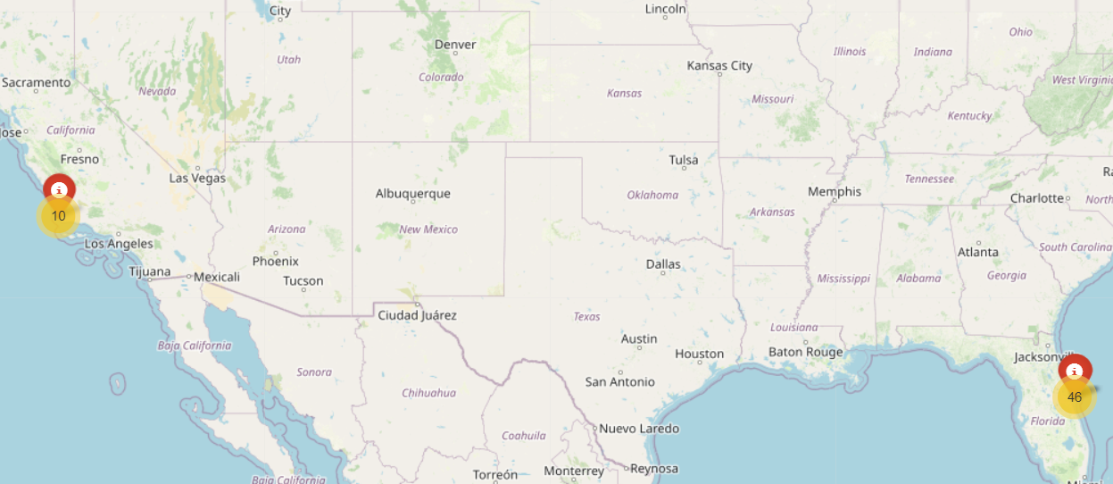
<Folium Map Screenshot 1>

Slide 29
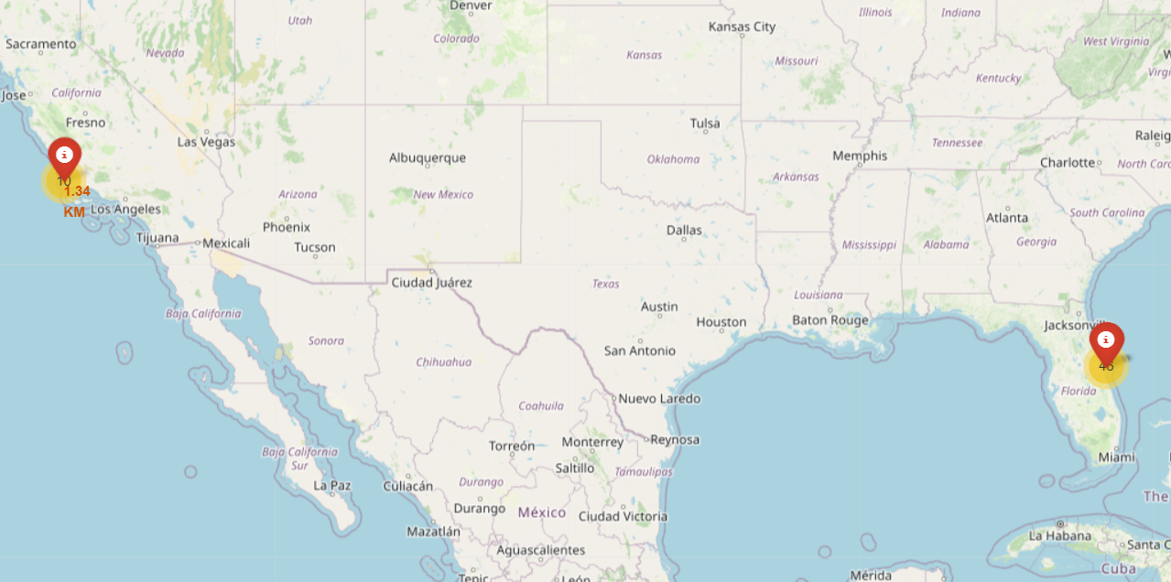
<Folium Map Screenshot 2>

Slide 30
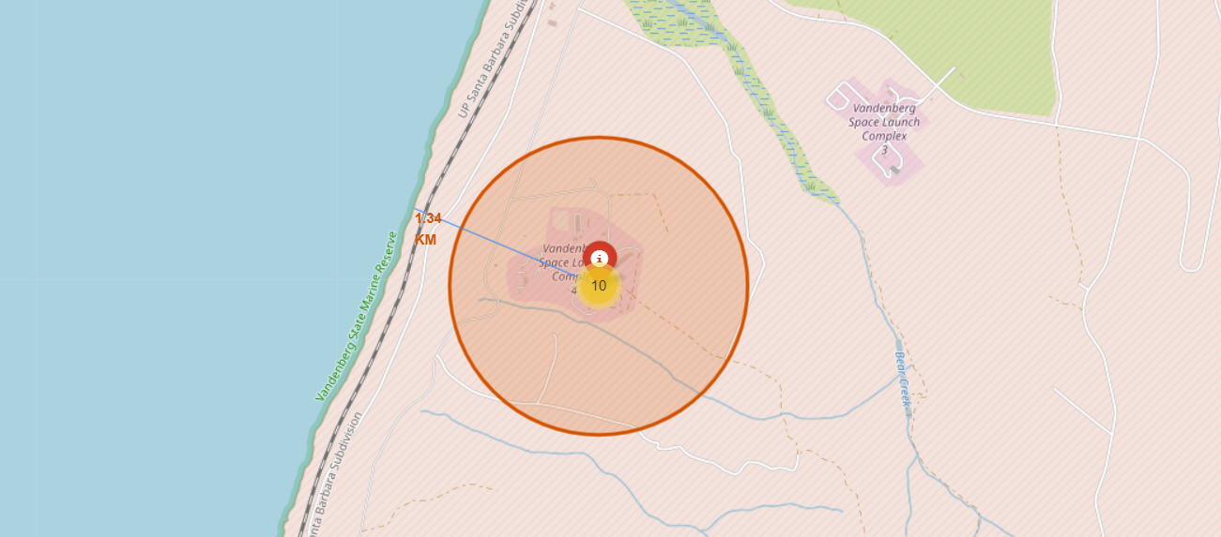
Nearest Coastline

Slide 31

Section 4

Slide 32
<Dashboard Screenshot 1>

Slide 33
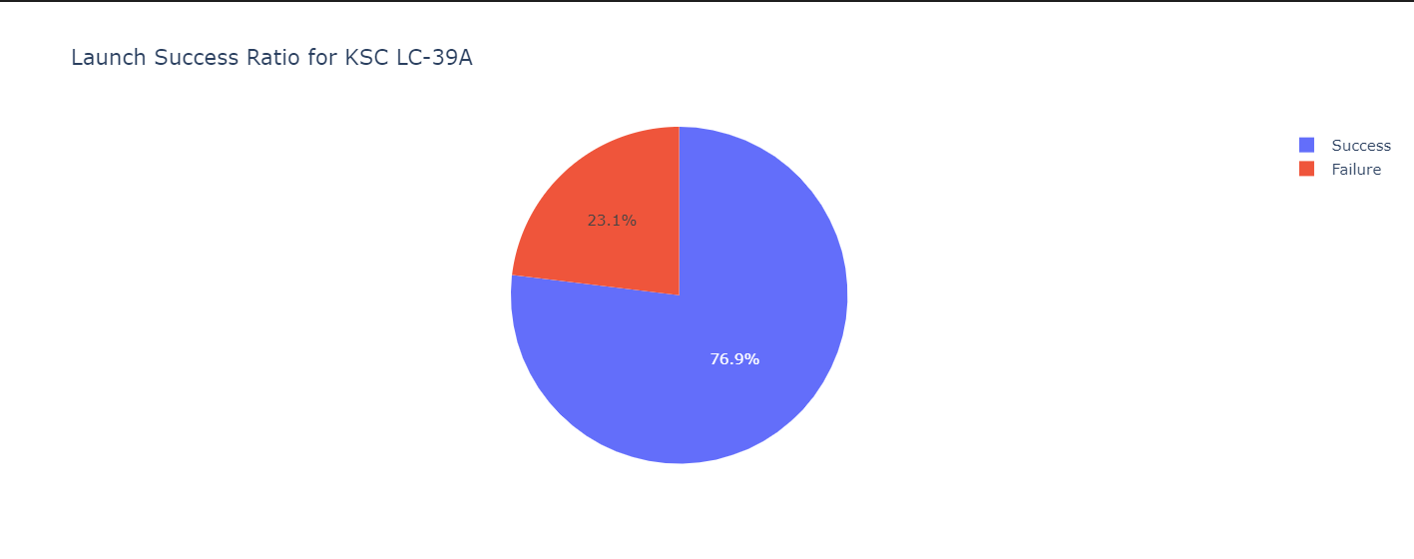
<Dashboard Screenshot 2>

Slide 34

Section 5

Slide 35
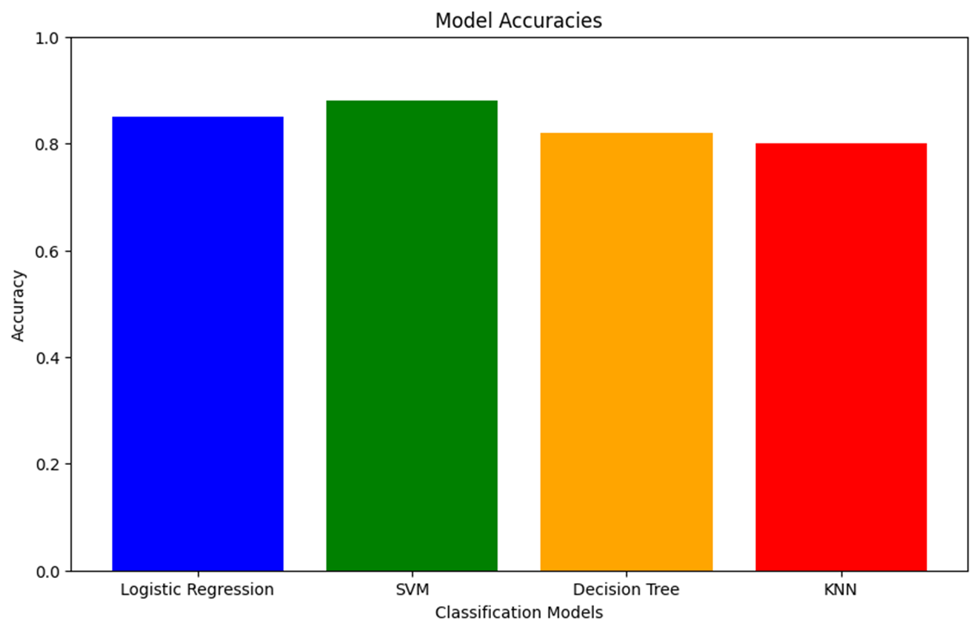
Classification Accuracy

Slide 36
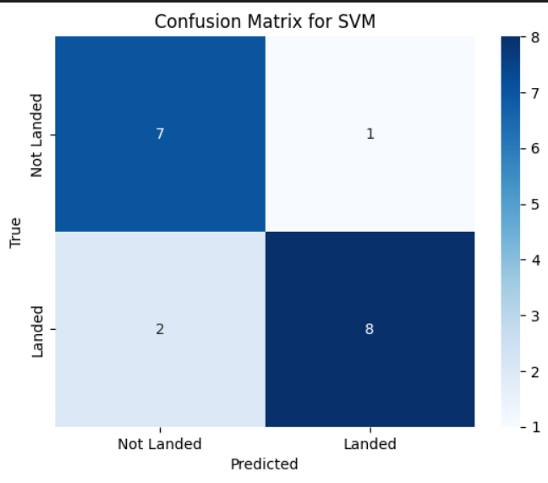
Confusion Matrix

Slide 37
Conclusions
1. Launch Site Impact: KSC LC 39A and CCAFS SLC 40 had higher launch volumes and success rates.
2. Payload Considerations: Mid-range payloads (3000–6000 kg) had the highest success rates.
3. Orbit Type and Mission Evolution:
SpaceX diversified mission types over time.
Initial missions were LEO-focused; later missions include GTO, SSO, polar orbits.
4. Visual Analytics: Folium maps enabled spatial insights into launch success and proximity factors.
5. Machine Learning: Random Forest achieved the best classification accuracy (~89%).
6. Business Insight: Data-driven analysis can improve planning for future missions, site allocation, and payload logistics.

Slide 38
Appendix
GitHub Notebook Links to each notebook:
https://github.com/rupin-gore/Data-Science-Capstone-Project/blob/main/1-data-collection-api.ipynb
https://github.com/rupin-gore/Data-Science-Capstone-Project/blob/main/2-webscraping.ipynb
https://github.com/rupin-gore/Data-Science-Capstone-Project/blob/main/3-spacex-Data%20wrangling.ipynb
https://github.com/rupin-gore/Data-Science-Capstone-Project/blob/main/4-eda-sql-sqllite.ipynb
https://github.com/rupin-gore/Data-Science-Capstone-Project/blob/main/5-eda-dataviz.ipynb
https://github.com/rupin-gore/Data-Science-Capstone-Project/blob/main/6-launch-site-location.ipynb
https://github.com/rupin-gore/Data-Science-Capstone-Project/blob/main/7-Machine-Learning-Prediction.ipynb

Slide 39


